Slide 1

Custom IDA Sidharth Bansal Employee Id : 655314

Slide 2
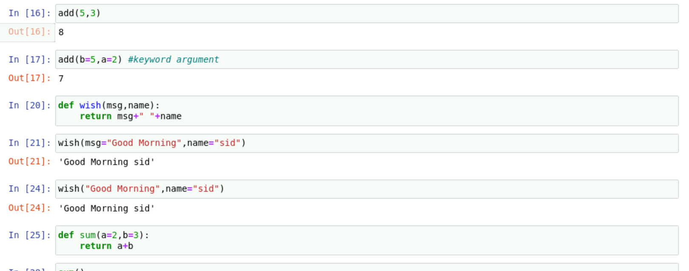
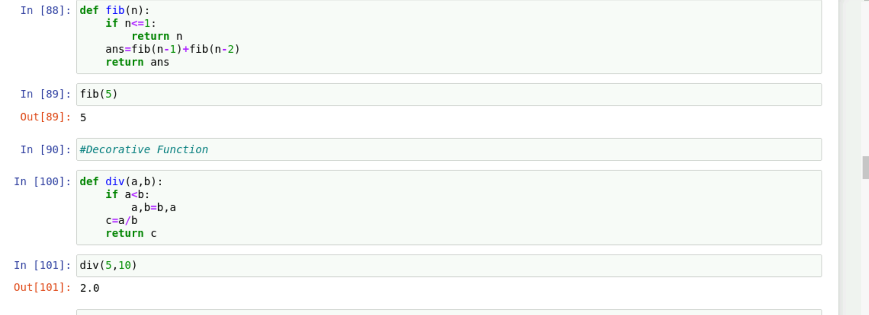
Day 2 19th September
Hands on data-structures like list and dictionary
Recursion and Intro to classes and objects
Functions like generator , lambda and decorative
Used functions like sort,upper and split
Learned about different types of arguments

Slide 3
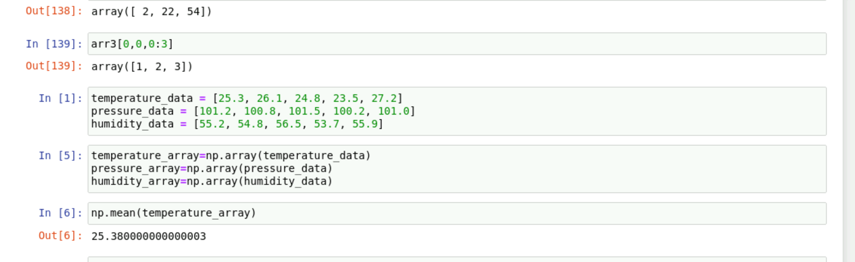
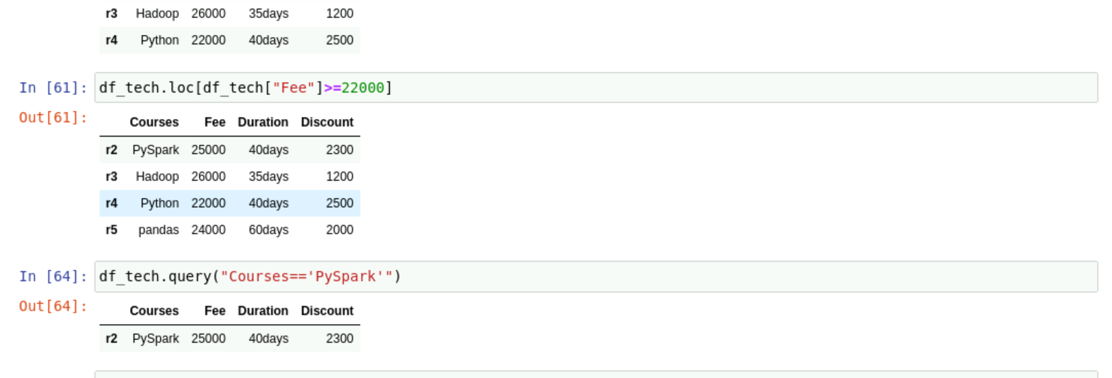
Day 3 20^{h} September
Introduction to pandas and matplotlib
Used function like head,tail,convert_dtypes and shape
Read csv using pandas
Hands on numpy arrays
Calculated mean,median and mode using numpy

Slide 4
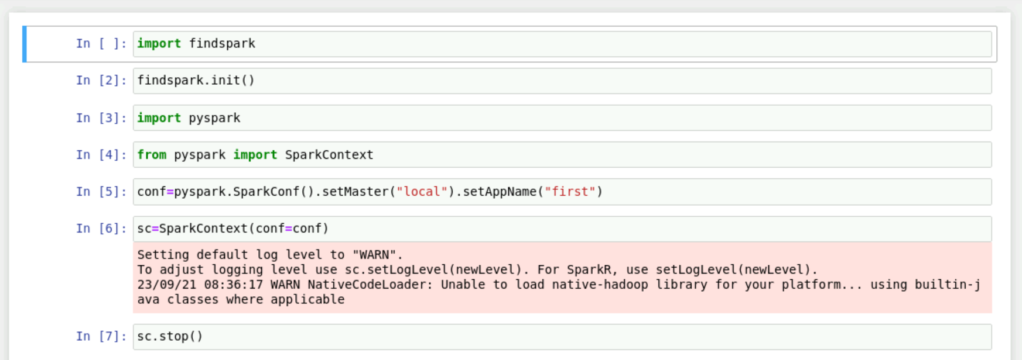
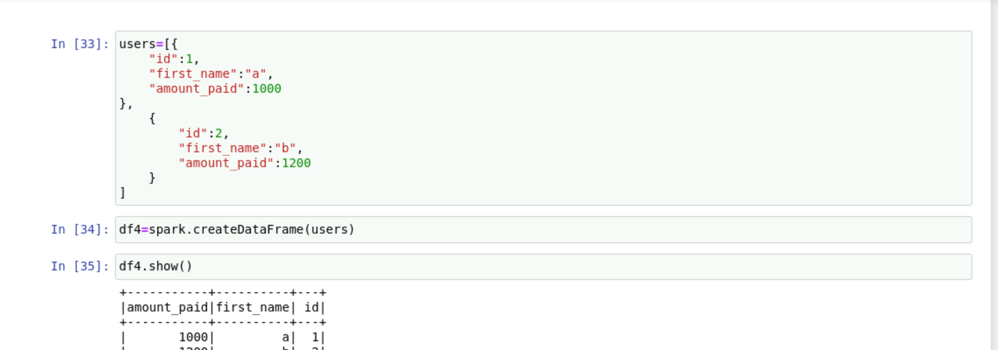
Day 4 21st September
Introduction to spark
Hadoop vs spark
Architecture of spark
Created spark context and spark session
Hands on creation of dataframe using csv file

Slide 5
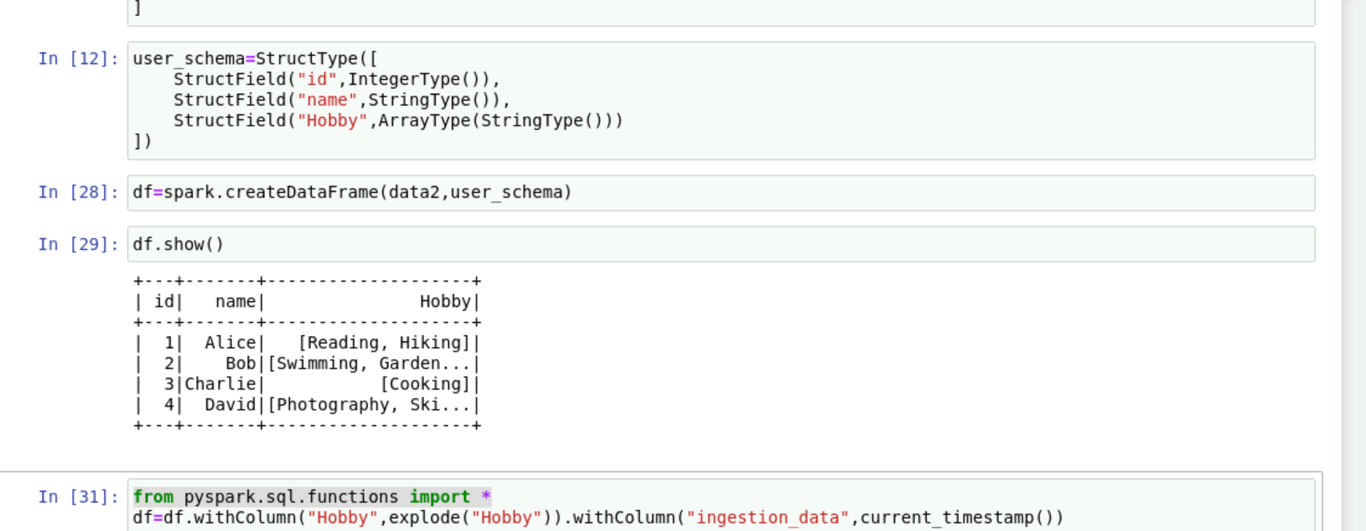
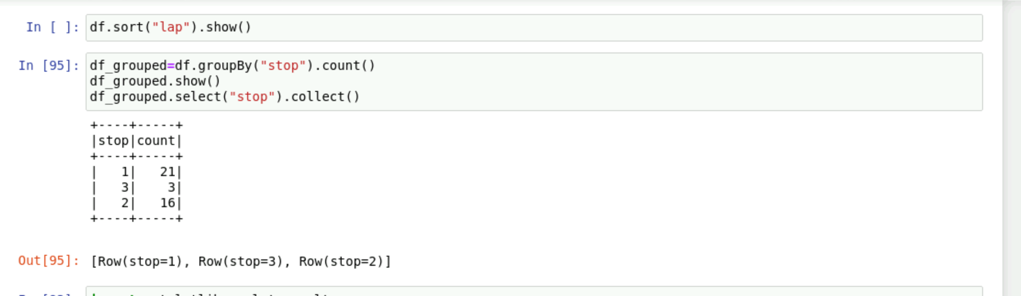
Day 5 22nd September
User defined schema vs inferschema
Learned about pyspark schema datatypes
Created schema for nested data
Hands on with different file formats like csv,json and parquet
Used groupby and sort on dataframe

